Slide 1

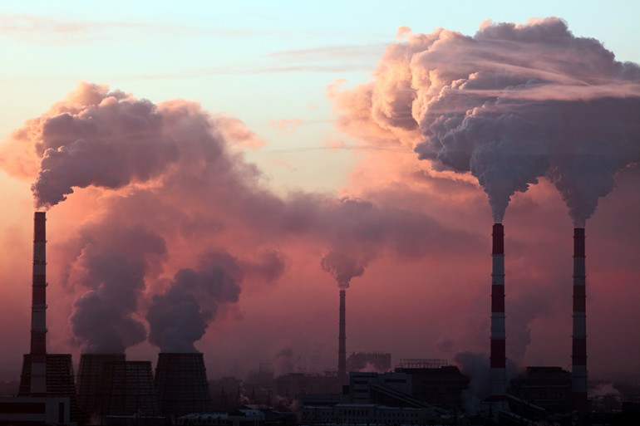
Graph Neural Network For Air Quality Forecasting
基於圖神經網路之空氣品質預測
組員: 1083513 張芮瑀 Emily
指導教授: 邱昭彰

Slide 2
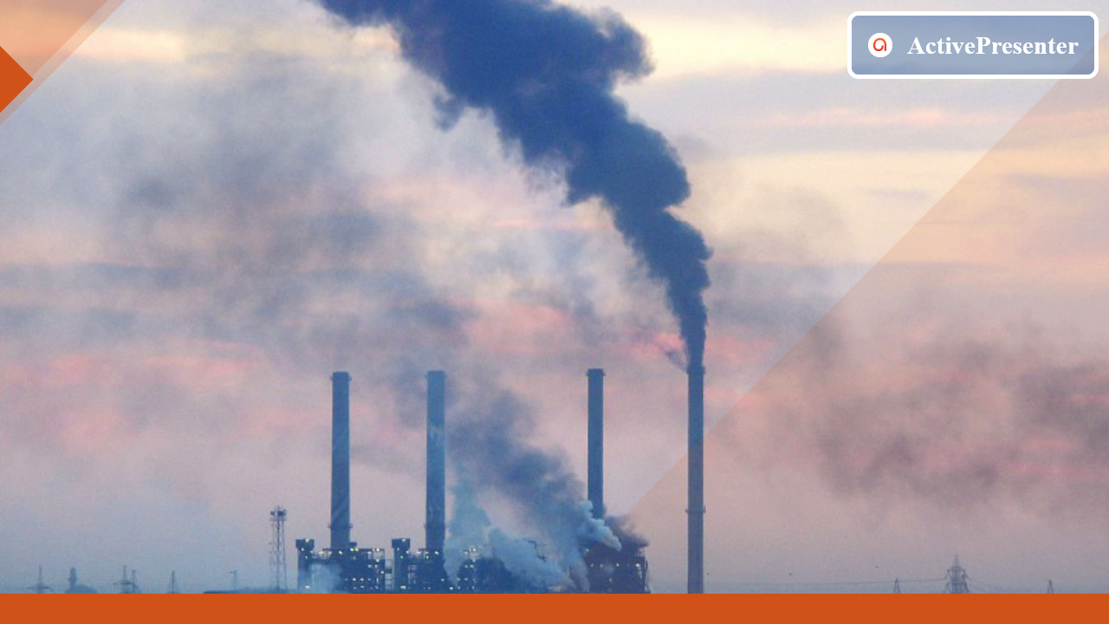
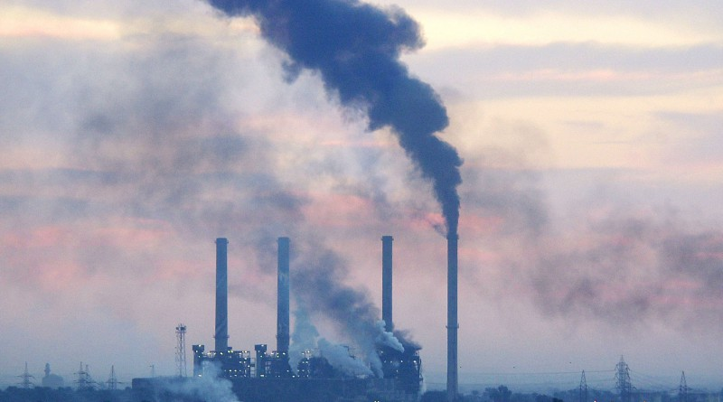
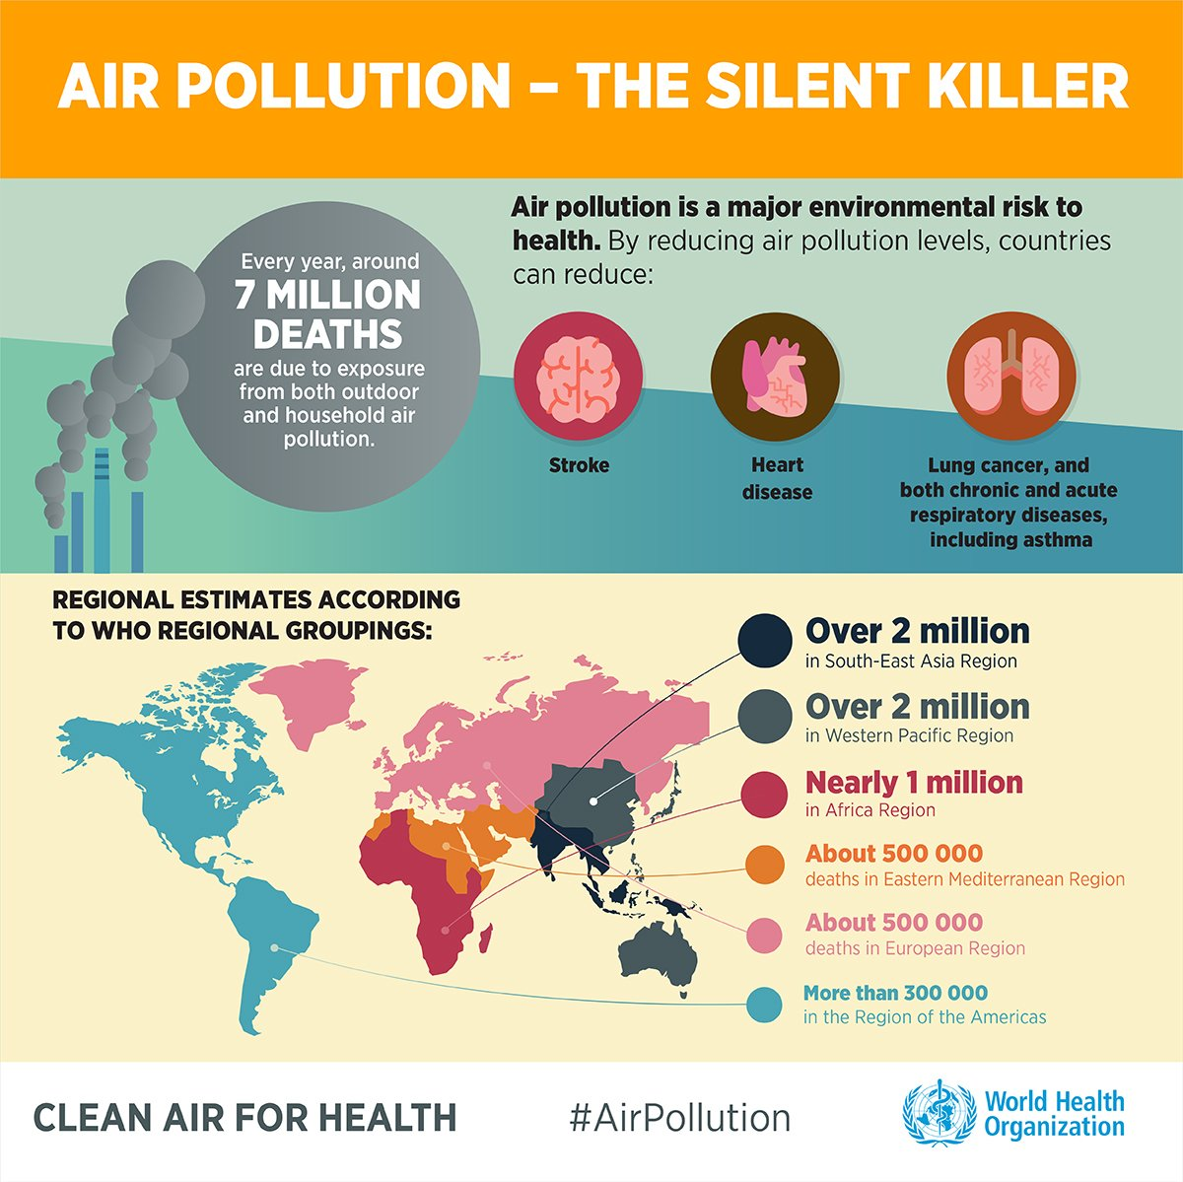
Effects of Air Pollution
28% Heart disease and stroke
43% Lung disease
29% Lung cancer
Air pollution causes 20,000 people early deaths each year in Taiwan.
1

Slide 3
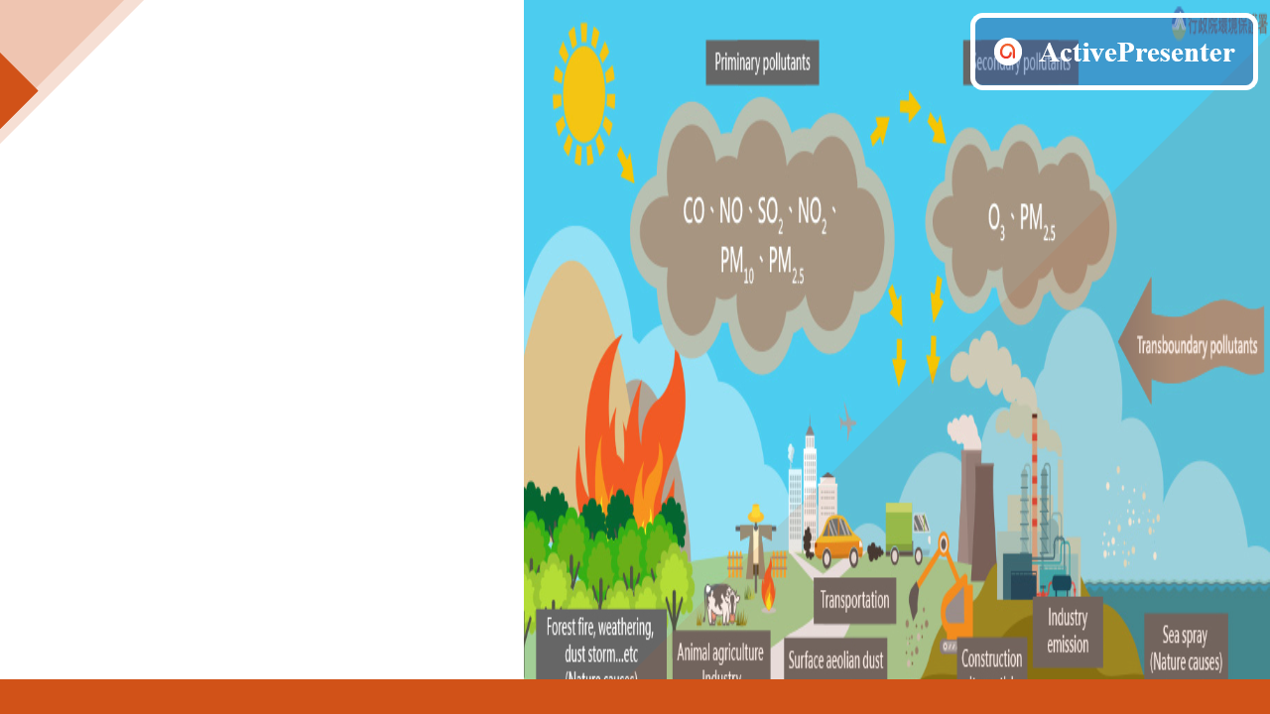
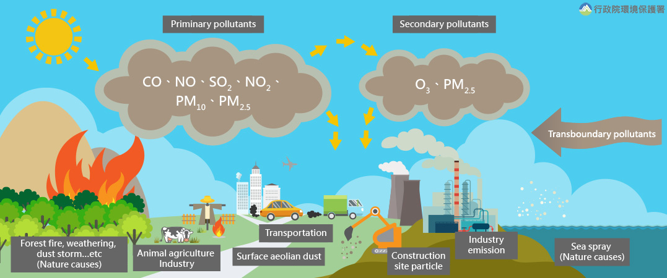
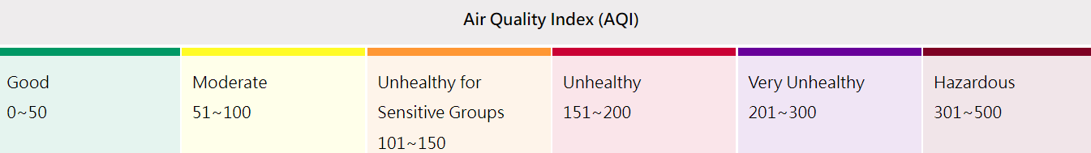
Definition of AQI
Based on the measurement of those solid and liquid particles.
60%
3

Slide 4
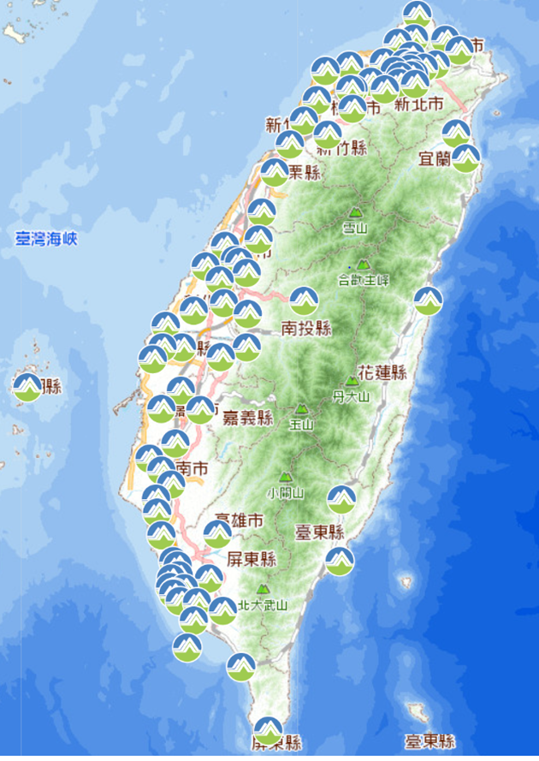
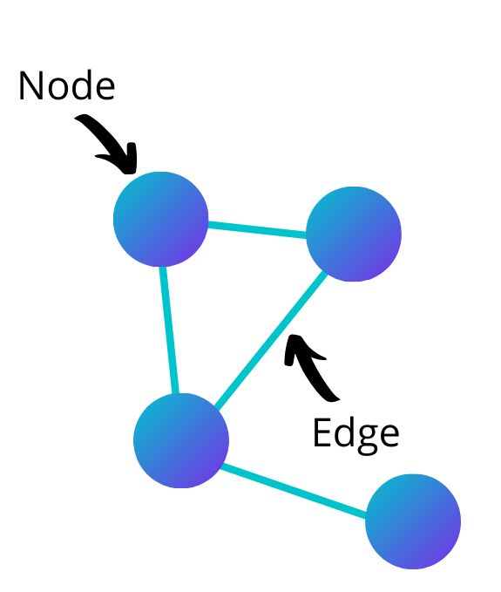
Air Quality Prediction
Why do we need GNN?
To process non-Euclidean data!
(Monitoring station)
Complex Air Quality Monitoring Network
Air pollutant (Hourly time series data)
Affected by many factors (such as weather, traffic volume).
4

Slide 5

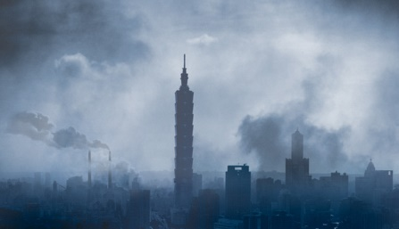
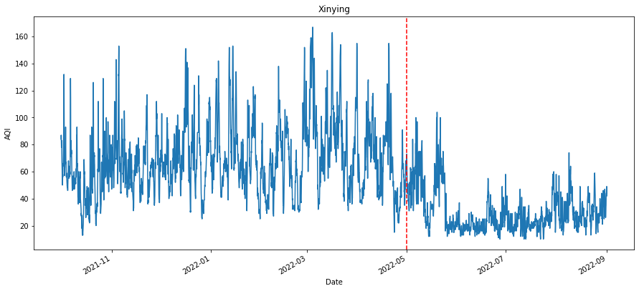
How Weather Affects Air Quality?
The two main factors:
(1) Wind direction
(2) Terrain obstruction
Stronger winds -> Lower air pollution concentrations
Northeast monsoon
(October to April)
Southwest monsoon
(May to September)
Nearly a year of Tainan air-quality distribution
6

Slide 6
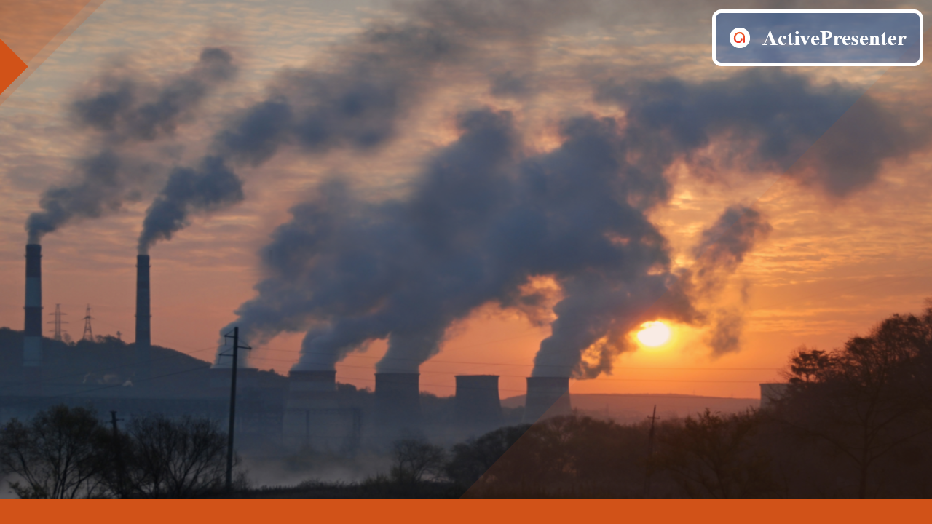
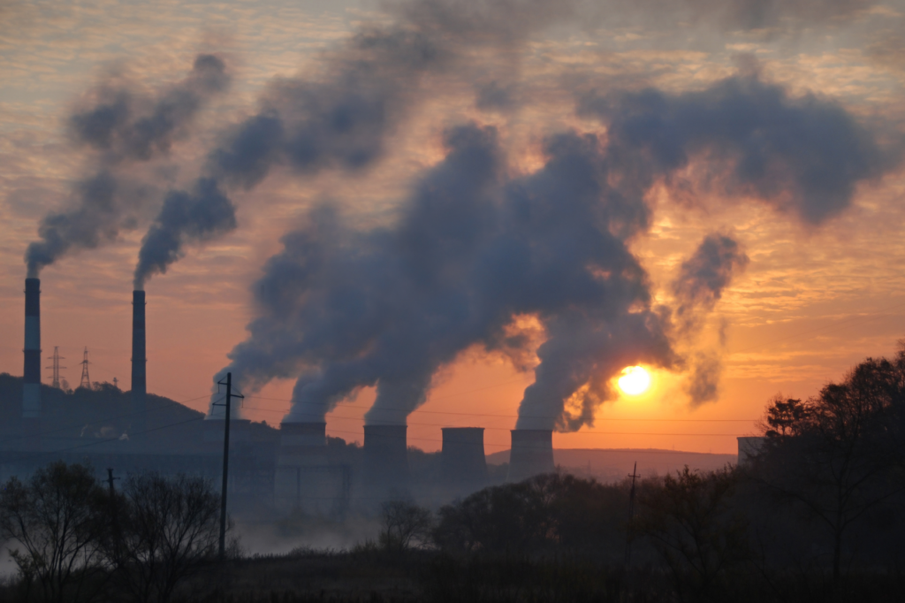

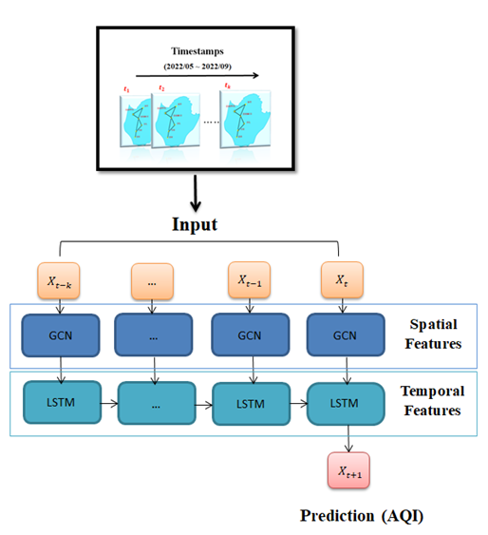
Research methods
Data Preprocessing
Filling missing value
Model
Dataset: Air quality index (AQI) (historical data, updated hourly)
Data filtering
Splitting data
Tainan
6 air monitoring stations
Southwest/Northeast
monsoon dataset
5

Slide 7
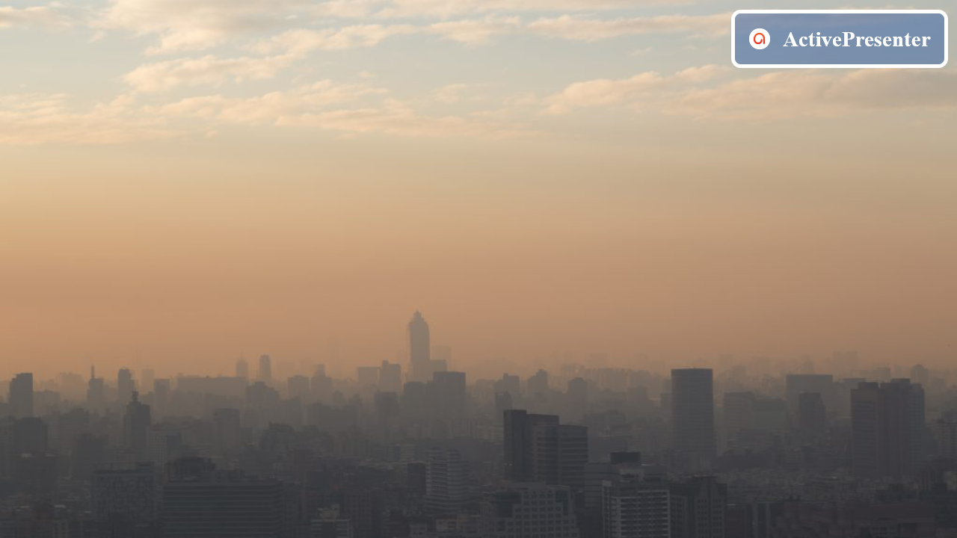
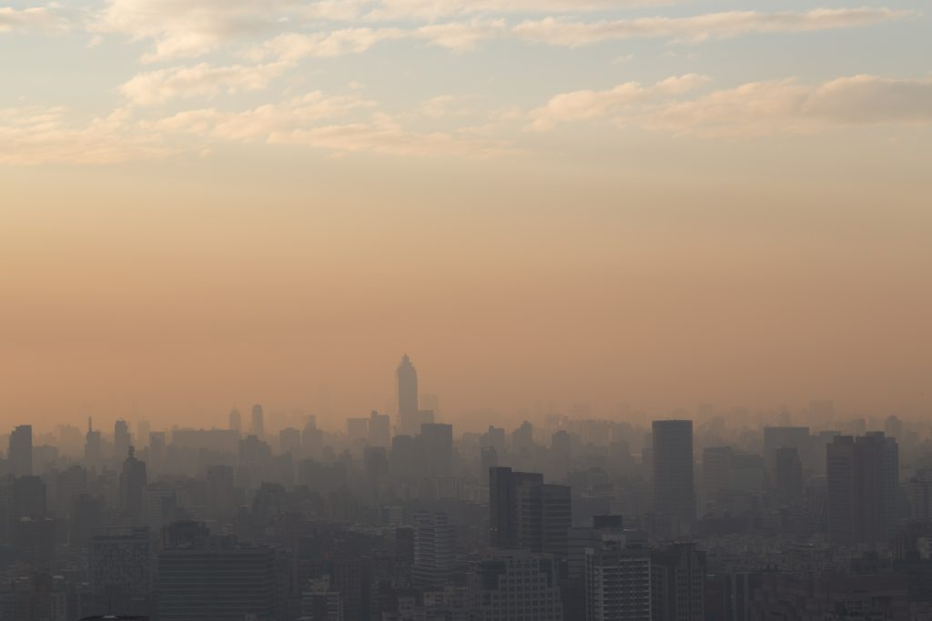
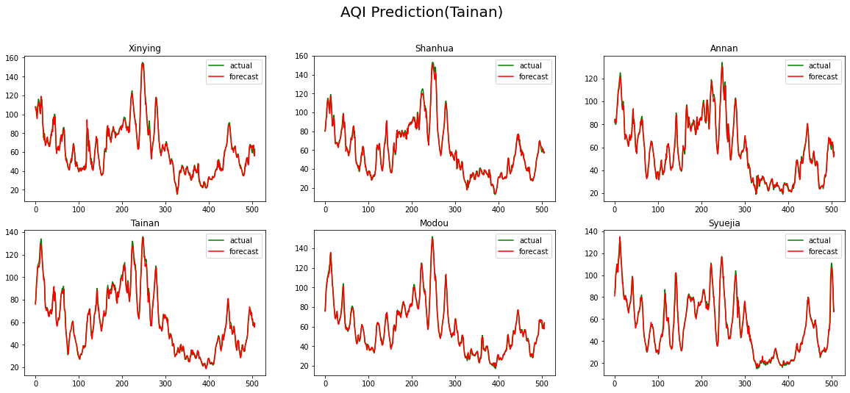
Results
AQI
Dataset: 2021/10/01 00:00 ~ 2022/04/30 23:00 (Northeast monsoon)
(Using the past 3 hours of data to predict the next 1 hour)
(Hours)

Slide 8

(Tainan)
Results
LSTM 3hr | RMSE | MAE | MAPE (%)
1hr later | 3.8938 | 2.7056 | 4.6262
2hr later | 6.9457 | 4.9455 | 8.3244
3hr later | 9.6321 | 6.9617 | 12.6157
GCN-LSTM 3hr | RMSE | MAE | MAPE (%)
1hr later | 3.1903 | 2.3181 | 4.4209
2hr later | 5.7727 | 4.2287 | 7.7201
3hr later | 8.5973 | 6.4668 | 12.0718
The results of this study evaluated both models using root mean square error (RMSE), mean absolute error (MAE), and mean absolute percentage error (MAPE).

Slide 9
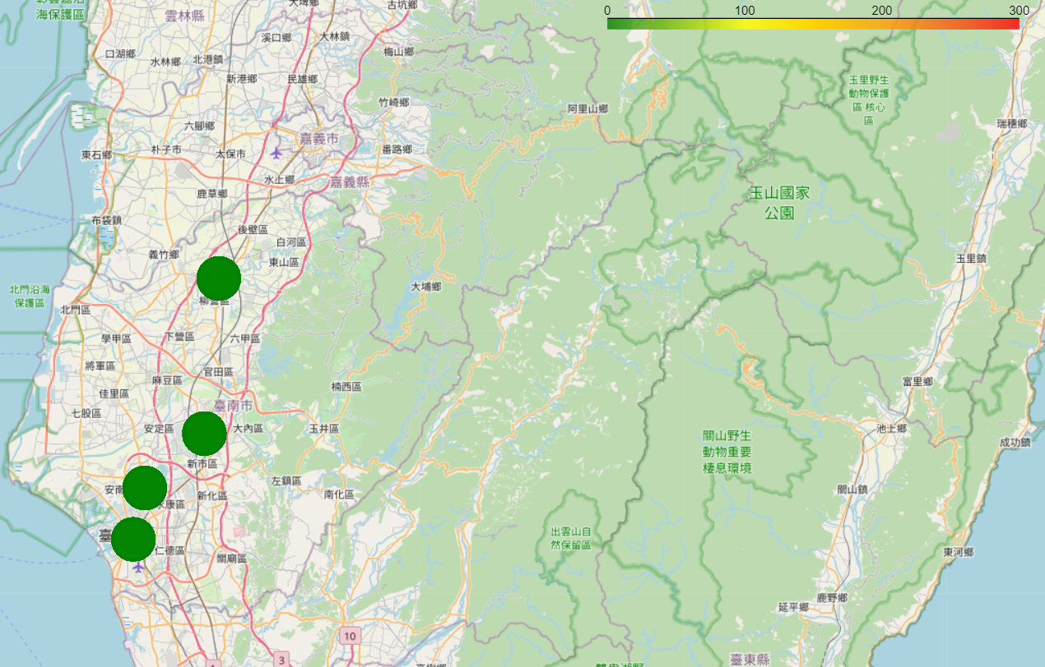
Future works
Add more nodes and features: Highly correlated with air quality, such as PM2.5, O3, wind direction, etc.
Data visualization: Using PHP and MySQL tools to present website information in the WordPress framework and apply it to the Leaflet map.
AQI | 0-50 | 51-100 | 101-150 | >150
Color | G | Y | O | R
Timeline

Slide 10
Thank You For Listening

